Slide 1
GOAP-Oriented Action Planning
By hualiang Zhao

Slide 2
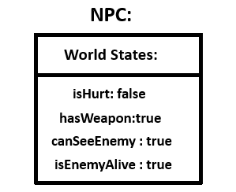
What is GOAP-Oriented Action Planning
GOAP-Oriented Action Planning(GOAP).
GOAP actions are not liked together like FSM.
GOAP will construct a graph to complete a goal on the NPCs current state and the actions that the NPC can do.

Slide 3
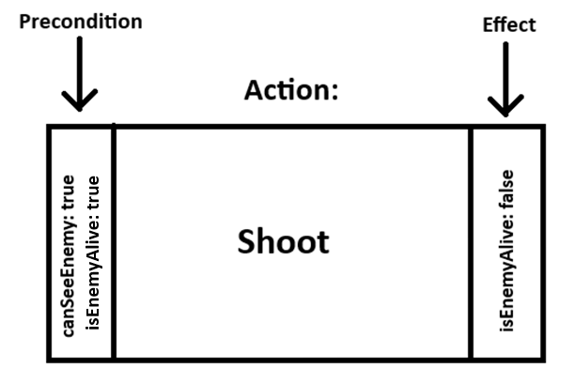
GOAP- ACTIONS
Actions consist of precondition and effect
Precondition is a state that needs to be met before the action can be done.
An effect is how the action leave the state of the agent or the world.

Slide 4
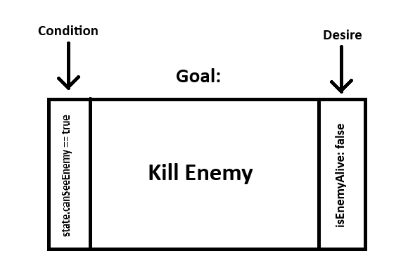
GOAP- GOALS
A goal consists of a condition and desire

Slide 5
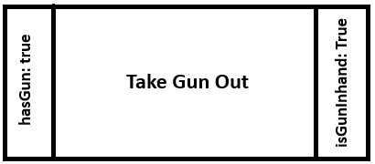
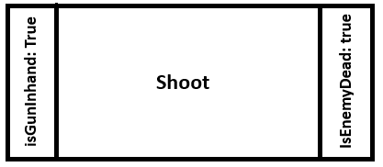
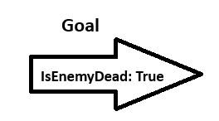
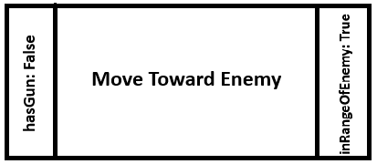
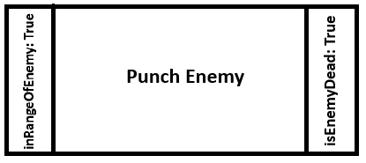
Constructing Graph
A set of actions can be used to construct an action chain.
Preconditions can be matched with effect
Effect can be matched with preconditions

Slide 6
If there more than one plan
A cost value will be assigned to each action
Whichever cost value is lowest at the end then the plan will be selected
A* and Dijkstra’s algorithm will be used to select the lowest cost path.

Slide 7
Dijkstra
Searches all paths for the most minimum cost path.
Disadvantage, poor performance since all nodes need to be visited first.
Dijkstra will always find the minimum cost path.

Slide 8
A*
Uses heuristic functions to calculate minimum cost path.
A* does not need to search through all nodes as long as the current path has reached the destination and is currently the shortest.
Notes:
Different heuristic function can cause different results

Slide 9
Video

Slide 10
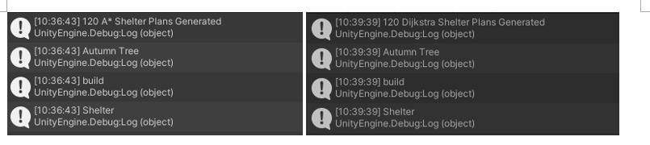

Results

Slide 11
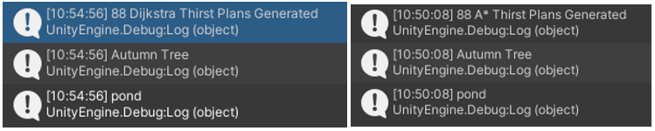
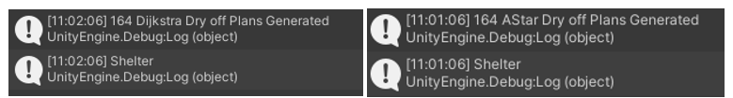
Result

Slide 12
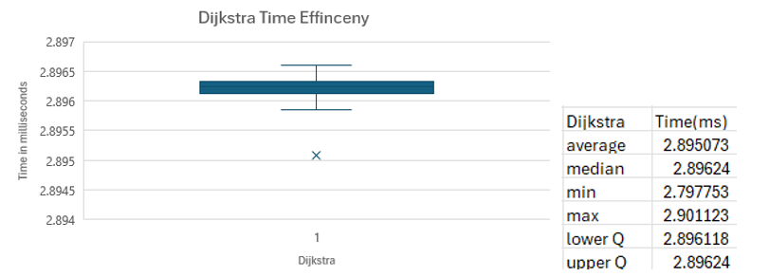
Results

Slide 13
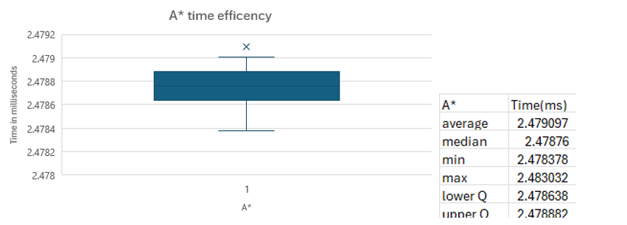
Results

